Slide 1

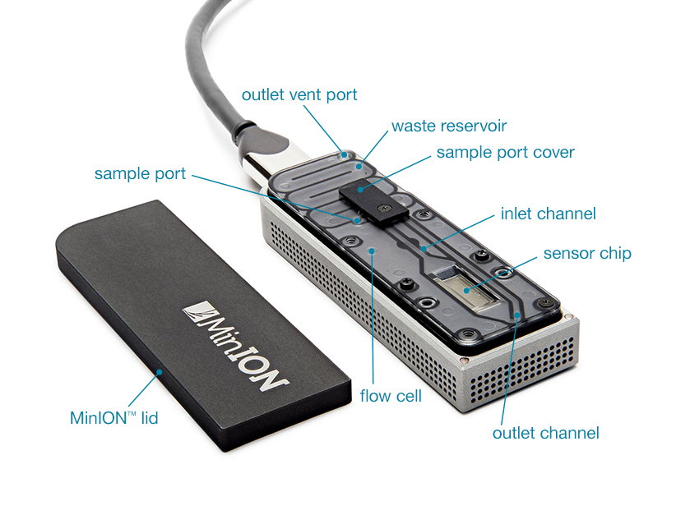
MinION Anatomy

Slide 2
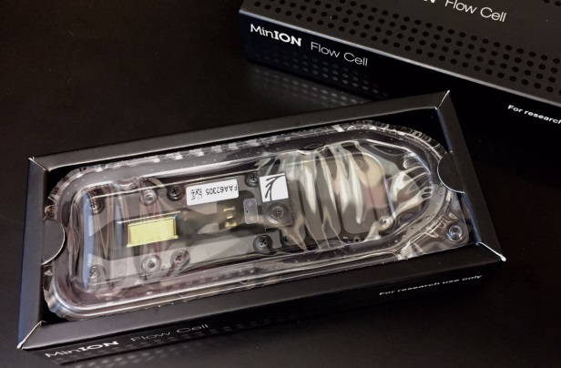
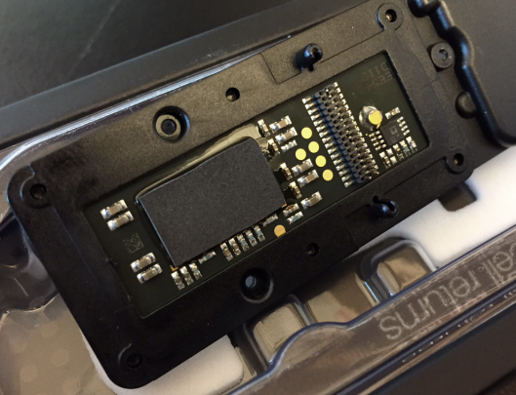
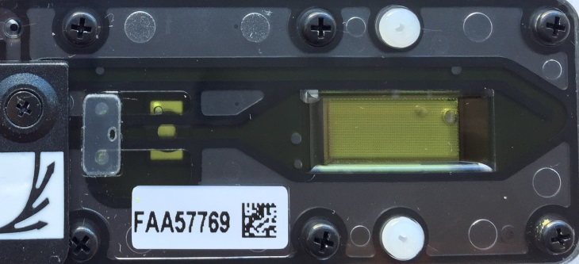
Pre-Run Check List
1
Make sure required Software is installed:-
MinKNOW Control of MinION device & run parameters
Metrichor Cloud basecalling of event data
MinoTour Live monitoring / control of run while sequencing
Chronolapse Screen image grabber for record keeping
Poretools, poRe Sequence extraction and data summaries
TeamViewer Remote control of MinION computer
2
Confirm automatic software updates and sleep modes are disabled
3
Check computer SSD for available storage space >150Gb
4
Flowcell inspection Remove bubbles in fluid lines and on surface of flowcell where possible if present, & confirm conductive heat pad is installed on bottom surface of ASIC chip.

Slide 3
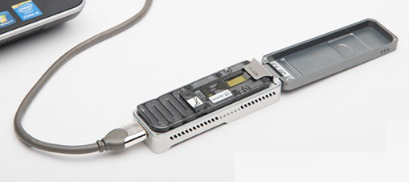
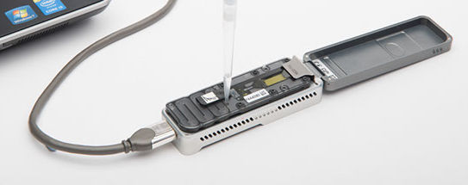
Preparing & Loading MinION Device
1
Attach Flowcell to MinION device and plug into USB3 port
2
Start MinKNOW software and start device
3
Name Run and start platform-QC protocol
If flow-cell good proceed
(Single Good pores >650)
4
Prime flow-cell with 2x 500μl 1xRBF1 for 10 mins each
(500μl 2xRBF1 + 500μl H₂O)
5
Load 150μl of Library in 1xRBF1
(75μl 2xRBF1 + xμl H₂O + 4μl Fuel + 6-11μl Pre-sequencing Mix)
6
Name run and start Sequencing Protocol – Standard / Modified :o)
(Start Metrichor & required workflow plus screen capture software)

Slide 4
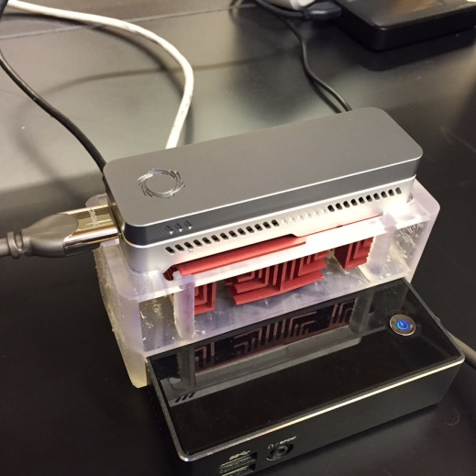
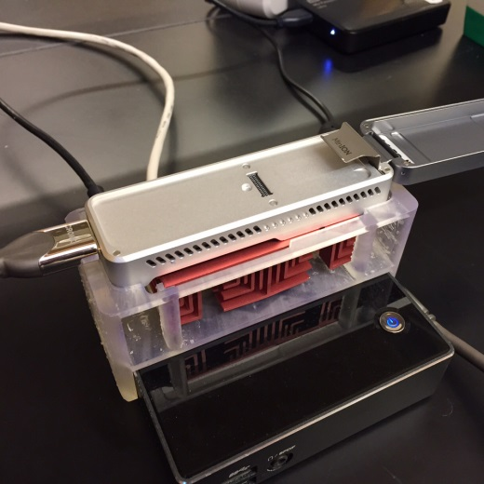
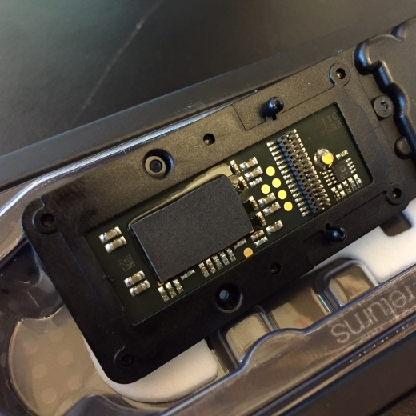
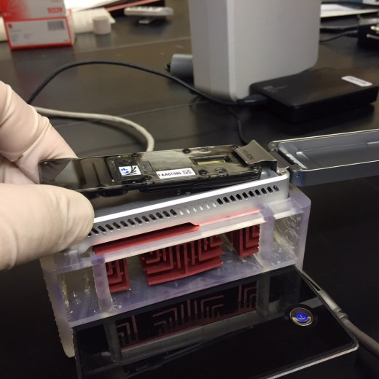
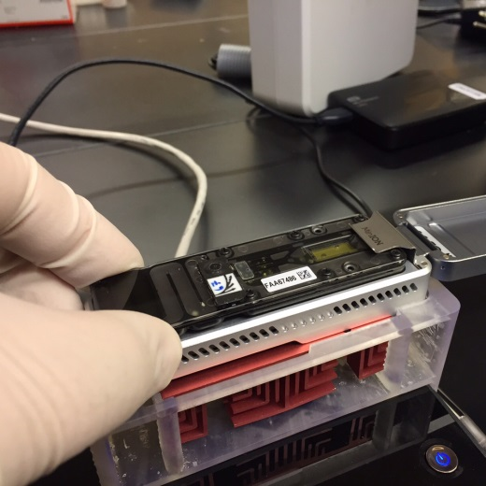
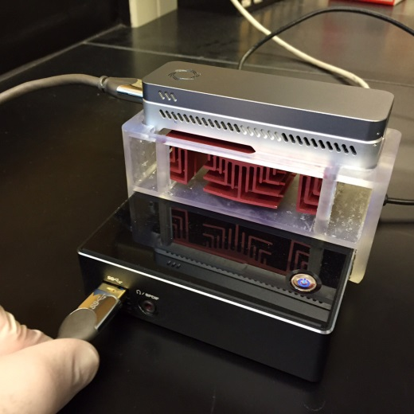
Inserting Flow-cell into MinION Device
1
2
3
Ready MinION
Open lid
Unpack flow-cell, check heat pad
intact & ASIC bubble free
4
5
6
Slide flow-cell into place
Make sure flow-cell is
seated properly
Plug MinION into USB3 port

Slide 5
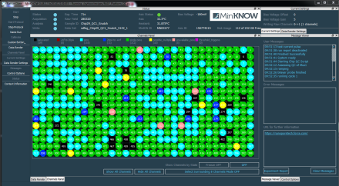
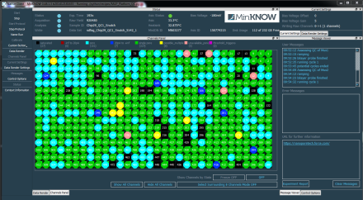
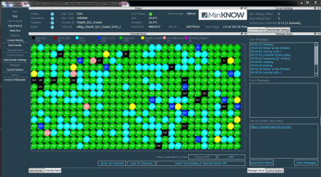
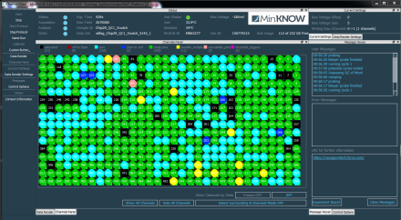
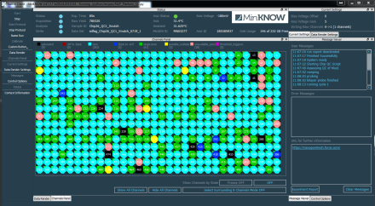
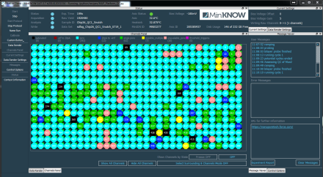
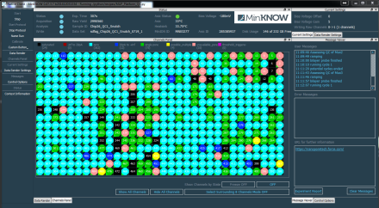
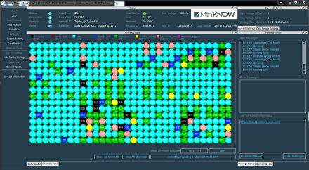
Flow-cell Quality Assessment
Platform-QC scans the 2048 channels as 4 Mux groups @ -180mV with R9 & reports back single good channel assignment to each of g1 to g4 groups with up to 512 wells each. Expect Good correlation using R9 flowcells between Platform QC pore numbers and those obtained at the start of a run.
Good
Bad
>650 Pore Guarantee

Slide 6
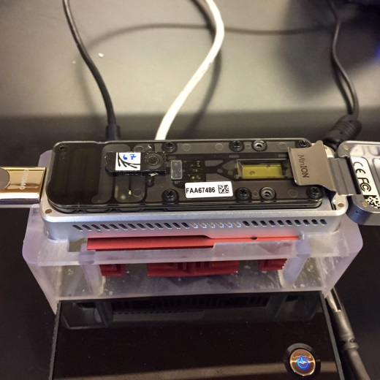
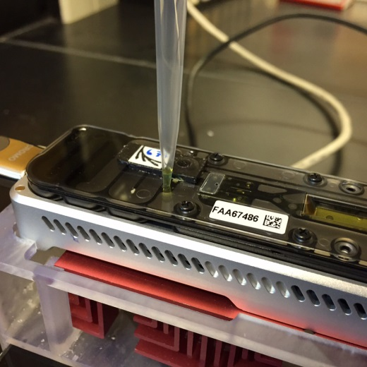
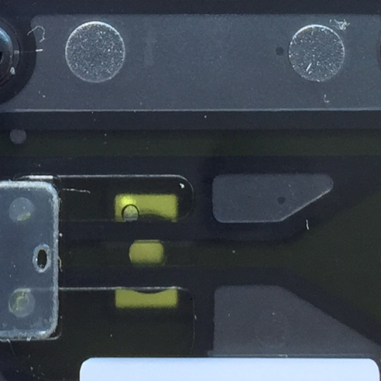
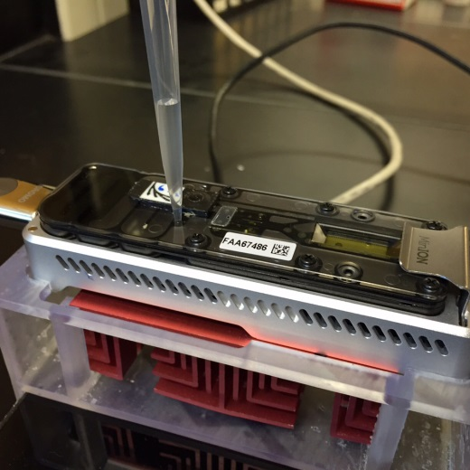
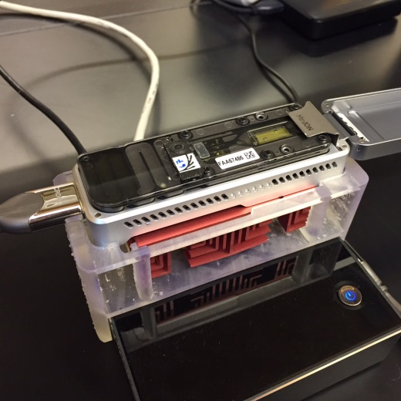
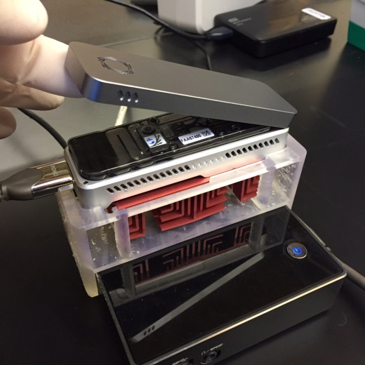
Priming and Loading Flow-cell
1
2
3
Open sample port
Slowly remove any air from sample port with pipette
Confirm fluidic channel is free of bubbles
4
5
6
2 x 10 min 500μl 1xRBF1 followed by 150μl Library
Close sample port
Close lid and GO!

Slide 7
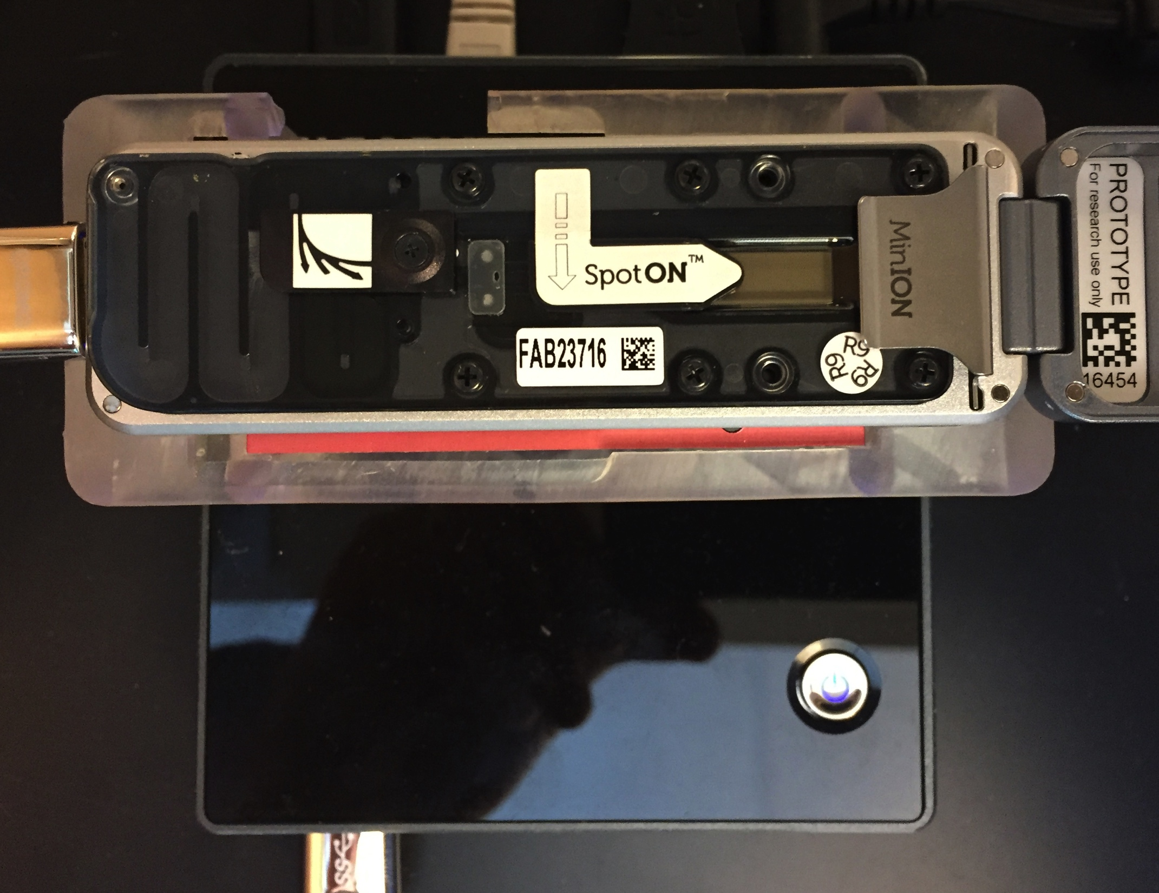
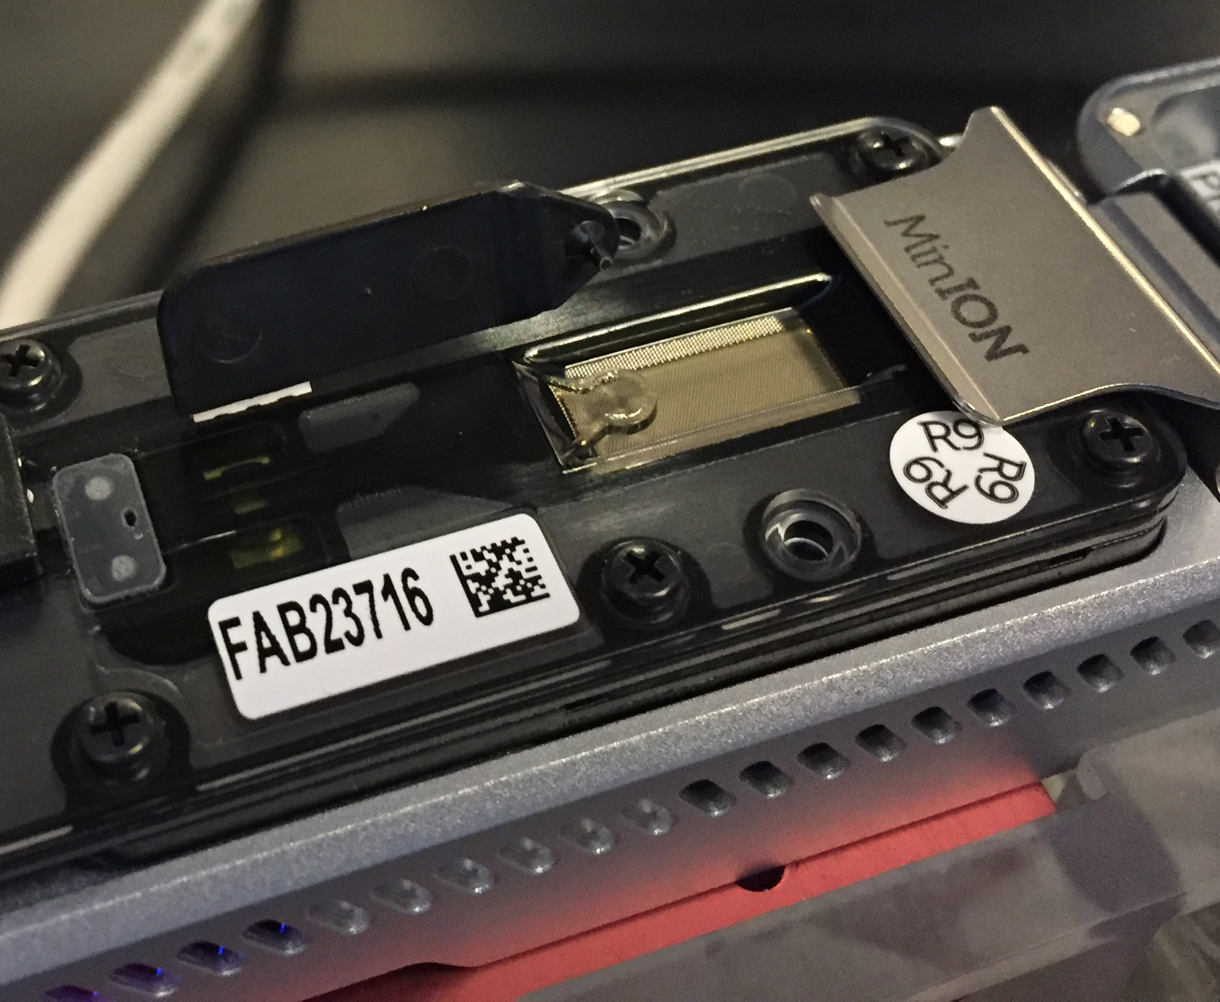
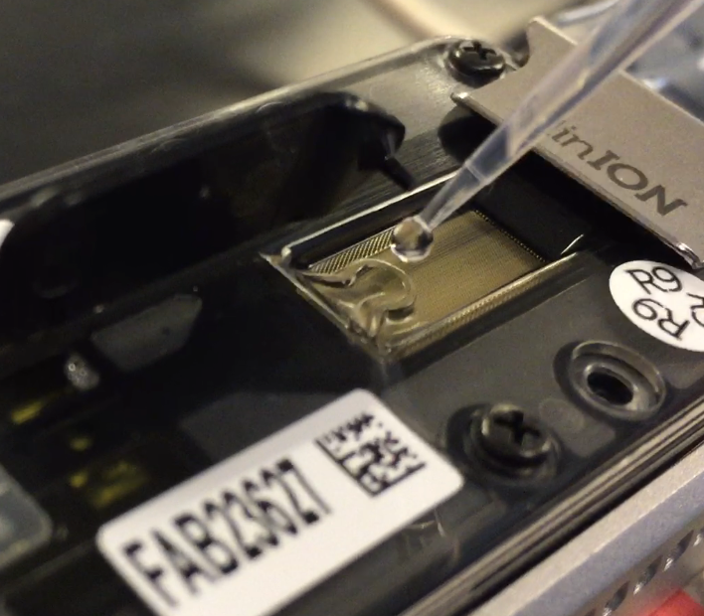
Priming and a Loading SpotON Flow-cell
1
Flowcell Priming
2
Slowly remove any air from sample port with pipette
1x 10 min 500μl RBF1 through sample port
1x 10 min 300μl RBF1 through sample port
Open sample port
3
4
Close ports, lid
and GO!
Open SpotON port and then add 200μl RBF1 through sample port, NOT SpotON port.
Add 75ul of Sequencing Mix to SpotON well dropwise

Slide 8
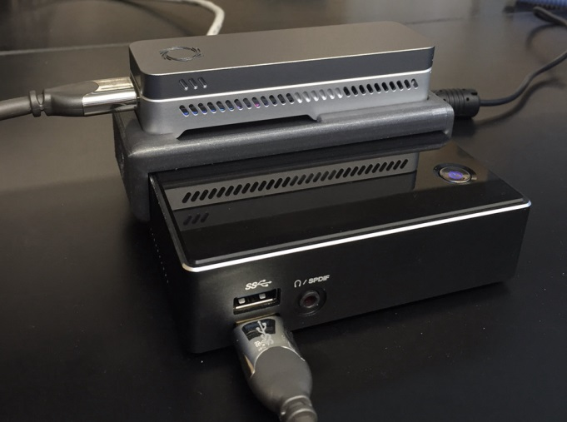

Start Run
1
Start Sequencing Recipe Script
Name run and select required Recipe Script
2
Start Chronolapse screen capture
Image grab every 30 seconds and as required at start
3
Start Metrichor workflow
Select desired workflow:- 2D basecall or WIMP
4
Start MinUp & Open MinoTour Browser Window
Issue command line parameters for read mapping and device control as below or use MinUP-GUI:
minUP.exe -dbh minotour.nottingham.ac.uk -dbu USER -pw PWD -w d:\data -f c:\reference\REF.txt -u USER -c -bwa -d -ip xxx.xxx.xxx.xxx -pin XXX -s minion

Slide 9
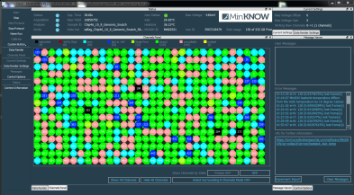
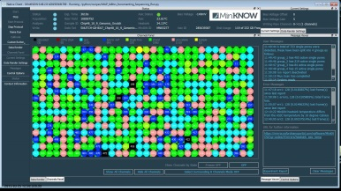
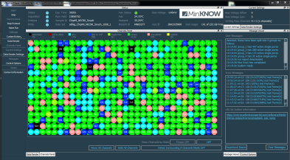
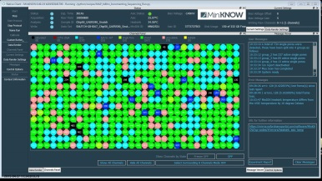
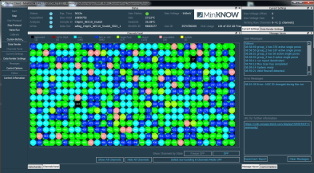
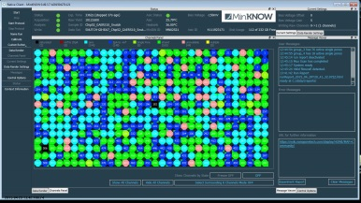
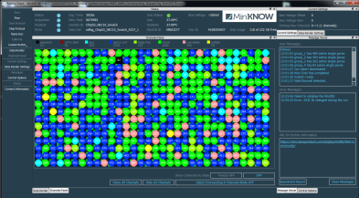
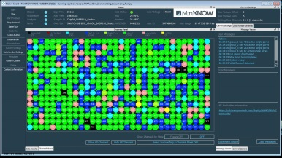
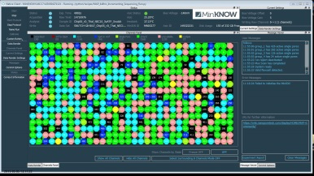
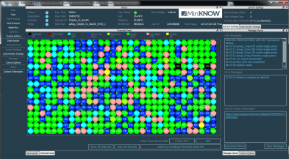
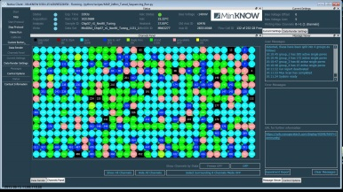
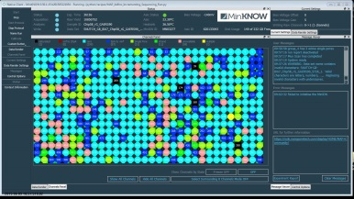
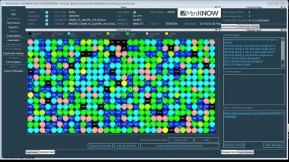
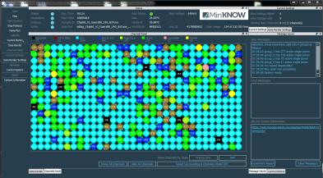
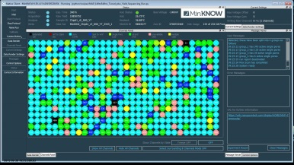
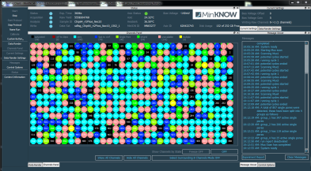
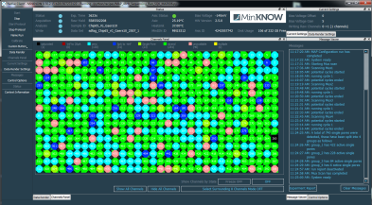
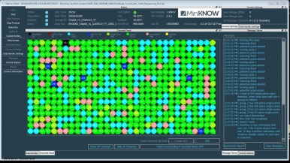
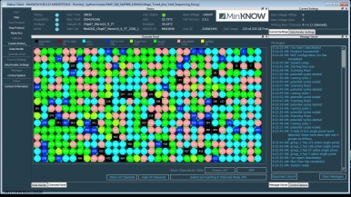
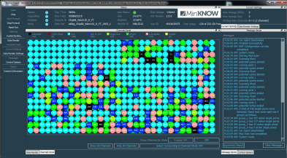
Good or Bad Library/Flowcell ?
95%
90%
97%
96%
91%
96%
84%
97%
93%
97%
97%
17%
83%
80%
83%
55%
92%
92%
86%
80%
% of Single Good pores in Strand

Slide 10


Single Good Pore % in Strand as Library QC
Use the relative quantity of in
Strand reads as a measure of
library quality independent
of pore number
292 / 302 = 97%

Slide 11
Script Tinkering
1
Bias-Voltage Setting & Remux
Bias voltage directly controls induced current flow across the membrane, and current flow is used to assign pores to different categories. With time greater bias-voltage is required to produce current that is in the “single good” pore range. Bias-voltage is the master control. Selection or “re-mux” of pores at a particular targeted voltage must be carried out for maximum efficiency.
2
Yield Monitoring
As pore numbers fall and/or reagent is depleted you will see a drop in the event yield over time. Gaining access to still functional, but unselected, pores once event accumulation rate drops below a set value makes much better use of a flow-cell. This lessens unproductive electrochemical gradient deterioration observed with standard recipe scripts.
3
Pore Shepherding
Wells actively sequencing experience an electrochemical gradient deterioration that is twice that of inactive pores, but even inactive pores show a deterioration that requires bias-voltage increases for optimal functioning. Because of the 4-1 (wells - electrical channel) nature of current flow-cells this results in a spreading of the optimal bias-voltage required for a particular well depending on its on/off history. To mitigate this, sub-peak bias-voltage selection can “shepherd” well population more tightly by attempting to deplete least used wells.

Slide 12





Standard 48hr Sequencing Recipe Script
R9 48hr Genomic DNA Sequencing Script
(example from previous R7.3 Version)
Mux @-180mV to assign g1, g2, g3 & g4 pores
g1
g1
8hrs
8hrs
g2
24hrs
g2
8hrs
8hrs
STOP
g3
8hrs
g1 to g2 switch
g4
8hrs
Example Pore Usage from retired R7.3
…

Slide 13










Modified Scripts to Maximise Flowcell Yields
-180mV
Start with fresh flow-cells
Yield dependent
time
After remux voltage scan
Yield-Monitoring_Voltage-Tuning Scripts
(If new flowcell use -180mV to start)
Multi-Voltage Re-mux
scan selecting one
within a defined
range of the greatest
“single good pore”
count voltage
15 min
Yield dependent time
Mux / Re-Mux Scan
After remux voltage scan
(Voltage tuned across 30mV
range)
x5 (user defined)
Switch when hourly
event yield drops
below 67% of first
hour of this segment
Yield dependent time
Yield Dependent Time
After remux voltage scan
(~1-5 hrs)
Example Pore Usage
Yield dependent time
…..

Slide 14


Run Dynamics:- SQK006 Standard Recipe Script
Event Accumulation
Abasic Current
Pore Usage

Slide 15


Run Dynamics:- SQK006 Tuning Recipe Script
Event Accumulation
Abasic Current
Pore Usage

Slide 16




Individual Pore Read Starts
Standard Script
(Chip65)
Individual Pore Read Starts
Tuning Script
(Chip66)

